Slide 1

SDE Readiness Training
Empowering Tomorrow’s Innovators

Slide 2

Module I
Java Software Development: Effective Problem Solving

Slide 3

OOPs Concept Realization
Learning Level: Basic
Date:

Slide 4
CONTENTS
Programming Paradigm
Object Oriented Programming

Slide 5


Programming Paradigm
Please download pictures in suitable size here and insert them by clicking the symbol above.

Slide 6
Overview
Programming Paradigm
Programming paradigm is a way or style of programming.
It defines the methodology of designing and implementing programs.
Three basic types
Unstructured Programming: It contains only one section, i.e., main. The main consists of sequence of commands and statements i.e. unable to use selection and repetition control statement constructs.
Structured Programming: It uses the structured control flow constructs of selection (if/then/else) and repetition (while and for), block structures, and subroutines.
Object Oriented Programming: Organized around objects. It combine data and action together.

Slide 7
Overview
Programming Paradigm
Types
Examples
Unstructured Programming
BASIC
Structured Programming
C
C ++
Object Oriented
Programming
C++
Java

Slide 8
Unstructured Programming
Programming Paradigm
Unstructured programming is the historically earliest programming paradigm capable of creating Turing-complete algorithms.
It uses unstructured jumps to labels or instruction addresses with the use of unstructured control flow using goto statements or equivalent.
Unstructured programming has been heavily criticized for producing hardly-readable ("spaghetti") code.

Slide 9
Unstructured Programming
Programming Paradigm
Advantages
Simple and easy to practice by novice programmer
Good for small program; no lengthy planning needed.
Speed and flexible
Provides full freedom to programmers to program as they want.
Disadvantages
No code reusability
Repetition of code
Cumbersome Maintenance
Debugging is tough

Slide 10
Structured Programming
Programming Paradigm
This programming paradigm aimed at improving the clarity, quality, and development time of a computer program by making extensive use of the structured control flow constructs of selection (if / then / else) and repetition (while and for), block structures, and subroutines.
Structured programming enforces a logical structure on the program being written to make it more efficient and easier to understand and modify.
The problem is bifurcated into number of small problems known as procedures (Also alternatively referred as functions or methods).

Slide 11
Structured Programming
Programming Paradigm
Advantages
Complexity can be reduced using modularity (divide and conquer)
Logical structures ensure clear flow of control.
Modules can be re-used many times; thus, it saves time and increase reliability.
Easier to update/fix the program by replacing individual modules rather than larger amount of code.
Disadvantages
Data is not secure
Code reusability is less
Can support the software development projects easily up to a certain level of complexity. If complexity of the project goes beyond a limit, it becomes difficult to manage.

Slide 12
Object Oriented Programming
Please download pictures in suitable size here and insert them by clicking the symbol above.

Slide 13
Need
Object Oriented Programming
People in real life have knowledge and can do a variety of tasks.
Objects in OOP include fields to store knowledge/state/data and methods to do various tasks.
Programmers need a programming model that enables them to work with real-world entities / objects.

Slide 14


Structured Vs Object Oriented - Overview
Object Oriented Programming
Break down a programming task into a collection of variables, data structures, and subroutines.
Break down a programming task into objects that expose behaviour (methods) and data (members or attributes).
Structured
Object Oriented
Subroutines:
Withdraw, Deposit, Transfer
Objects:
Customer, Money, Account

Slide 15
Structured Vs Object Oriented - Overview
Object Oriented Programming
Structured
Object Oriented
Data
Local Data
Global Data 1
Functions
Function 1
Global Data 2
Local Data
Data
Functions
Function 2
Global Data 3
Local Data
Data
Functions
Function 3

Slide 16
Features
Object Oriented Programming
Class
Polymorphism
Object
Object Oriented Programming Concepts
Inheritance
Abstraction
Encapsulation

Slide 17





Object - What it is?
Object Oriented Programming
Object is the key element to understand object-oriented technology.
It is a real-world entity.
Everything is an object in the real world
Real world Objects

Slide 18
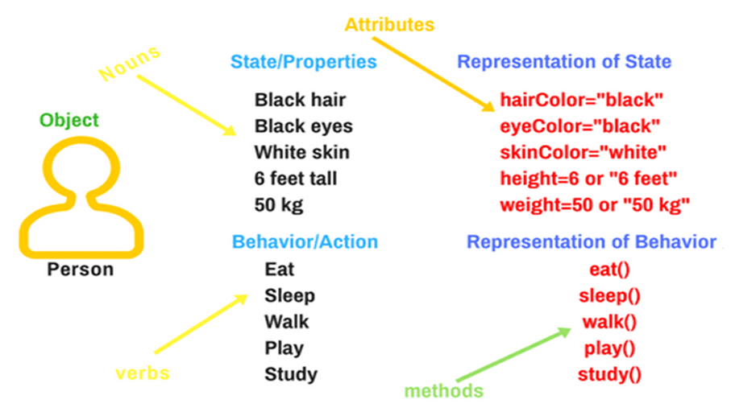
Object - What will it have?
Object Oriented Programming
Real-world objects share three characteristics: State, Behavior and Identity.
The state of an object can be described as a set of attributes and their values.
The behaviour /operation/action of an object refers to the changes that occur in its attributes over a period.
Identity is the name that identifies the object.

Slide 19
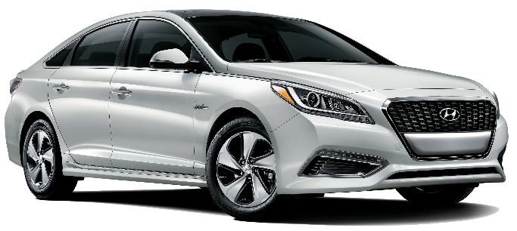
Object – Real Life Example
Object Oriented Programming
State / Properties
Representation of State
Silver body
12 lakh rupees
45000 kms
Manual gear
Diesel engine
color=“silver”
price=“12 lakh rupees”
mileage=“45000 kms”
transmission=“manual gear”
engine_type=“diesel engine”
Object: Car
Behaviour / Action
Representation of Behaviour
Acceleration
Gear Change
Slowing Down
Reversing
acceleration()
gear_change()
slowing_down()
reversing()
Identity: It is a Hyundai Verna

Slide 20
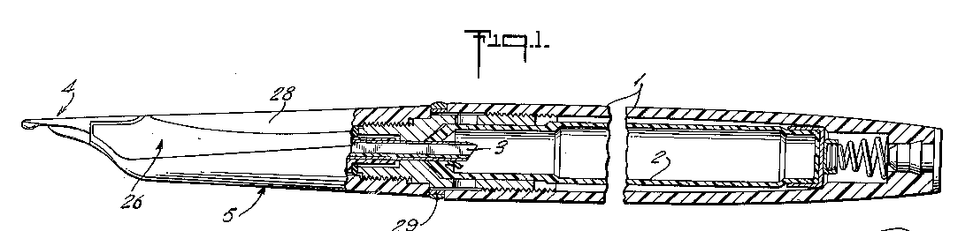



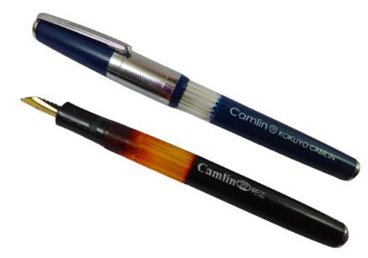
Class
Object Oriented Programming
Class is a group of objects with similar properties, common behaviour, common relationships with other objects, and common semantics.
A class is the template / blueprint from which individual objects are created.

Slide 21
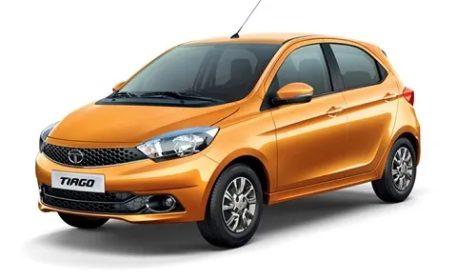
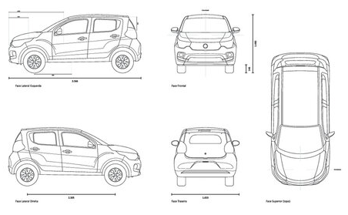
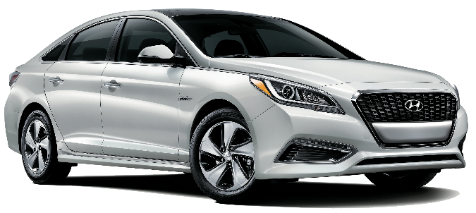
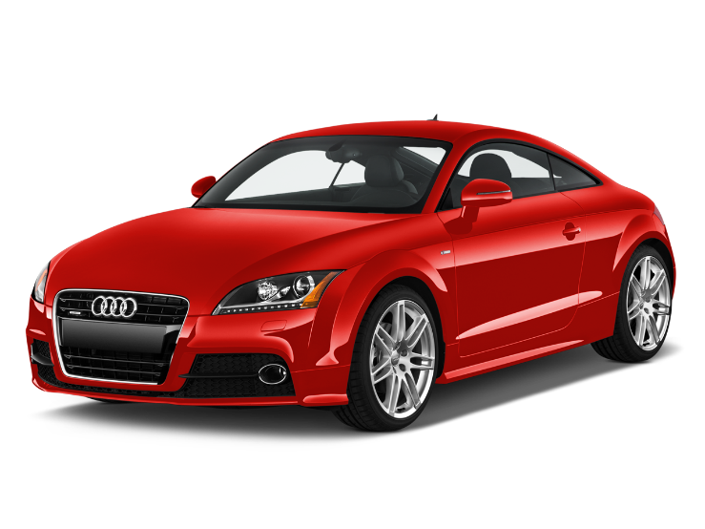
Class – Real Life Example
Object Oriented Programming
Class Car
A class is like a blueprint for creating cars. It defines what features and behaviors a car can have. E.g., class specifies that every car should have attributes like color, brand, wheels, and behaviors like start, accelerate, stop. It is a group of individual cars with similar properties and actions.

Slide 22
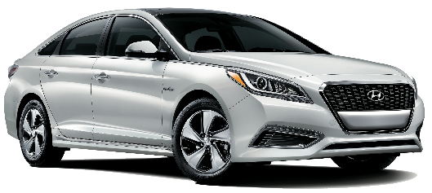


Object and Class
Object Oriented Programming
Object Oriented Programming
Objects
Color: Silver
Transmission: Manual
Brand: Hyundai
Mileage: 45, 000 kms
Fuel Type: Diesel
A silver Hyundai car with manual gear, diesel fuel type, and 45,000 kms mileage.
Class – Car
States
Color
Transmission
Brand
Mileage
Fuel Type
Color: Red
Transmission: Automatic
Brand: Audi
Mileage: 47, 500 kms
Fuel Type: Electric
A red Audi with automatic gear, 47,500 kms mileage, and electric fuel type.
Behaviors
Color: Orange
Transmission: Manual
Brand: Tata
Mileage: 35, 800 kms
Fuel Type: Petrol
An orange Tata car with manual transmission, petrol fuel type, and 35,800 kms mileage.
Accelerate
Reverse
Park

Slide 23
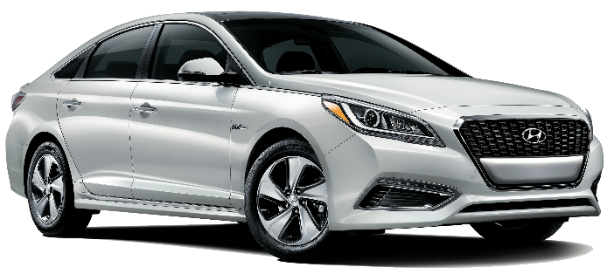
Object – Instance of a class
Object Oriented Programming
Instances of Car class
Color: Silver
Transmission: Manual
Brand: Hyundai
Mileage: 45, 000 kms
Fuel Type: Diesel
Car 1
States
Color:
Transmission:
Brand:
Mileage:
Fuel Type:
Color: Red
Transmission: Automatic
Brand: Audi
Mileage: 47, 500 kms
Fuel Type: Electric
Car 2
Behaviors
Acceleration()
Reversing()
Park()
Color: Orange
Transmission: Manual
Brand: Tata
Mileage: 35, 800 kms
Fuel Type: Petrol
CAR
Car 3

Slide 24
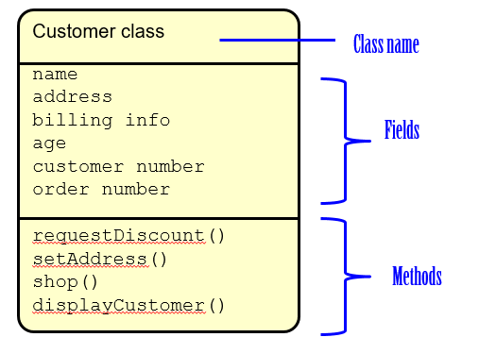
Class diagram
Object Oriented Programming
Object Oriented Programming
Properties and Behaviors of ‘Car’ class
Car class
brand
model
year
transmission
fuel type
mileage
accelerate()
reverse()
brake()
Properties:
brand
model
year
transmission
fuel type
mileage
Behaviors:
accelerate()
reverse()
brake()

Slide 25
Abstraction
Object Oriented Programming
Data abstraction is providing only what is relevant/essential information about the data to the outside world, hiding the irrelevant/background details/implementation.
For Example, when you send an email to someone you just click send and you get the success message.
What actually happens when you click send?
How data is transmitted over network to the recipient?
All these are hidden from you (because it is irrelevant to you).

Slide 26
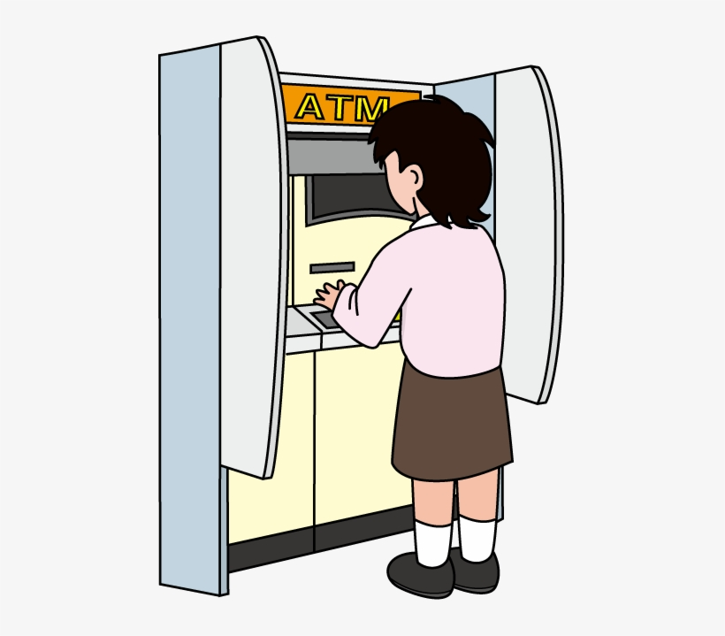

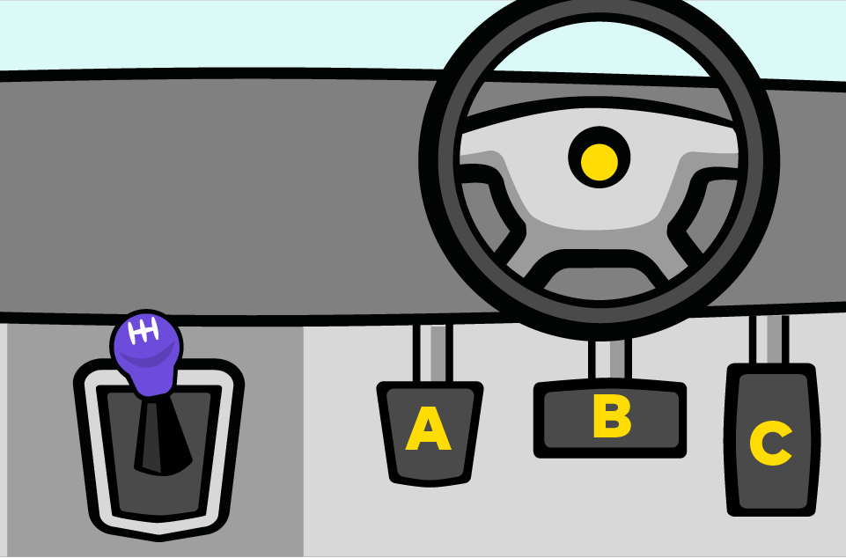



Abstraction
Object Oriented Programming
Object Oriented Programming
Musician need not to know how the sound is produced. All they need to know is which key to press
ATM user need not to know what is the process behind the screen.
Car driver need not know how the engine works, all they need to know is which pedals to press and which gear to shift
Note: Abstraction is providing only relevant/essential information to the user.

Slide 27


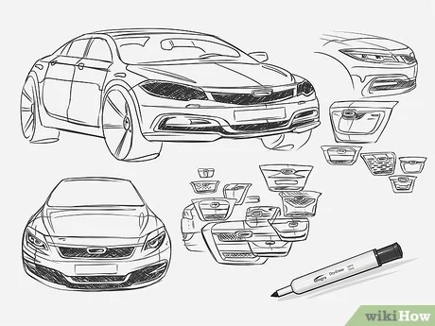




Abstraction – Real Life Example
Object Oriented Programming
Driver / User
Engineers
Designers
Note: An abstraction includes the essential details relative to the perspective of the user.

Slide 28


Encapsulation
Object Oriented Programming
Encapsulation refers to the process of bundling the data (attributes or variabzzles) and methods (functions or procedures) that operate on the data into a single unit, called a class.
It's like a capsule that protects the inner workings of an object. This helps keep code organized, makes it easier to understand, and prevents outside interference with the internal data.
Medicines are not directly accessible / protected from outside
Methods
Class
Variables

Slide 29
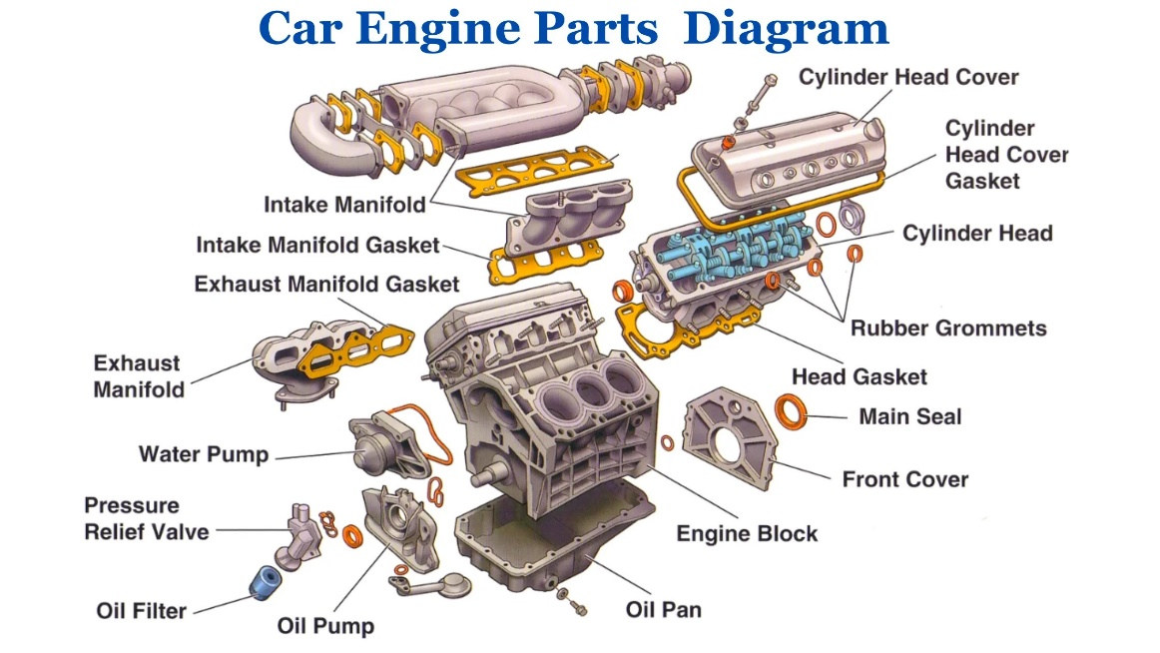
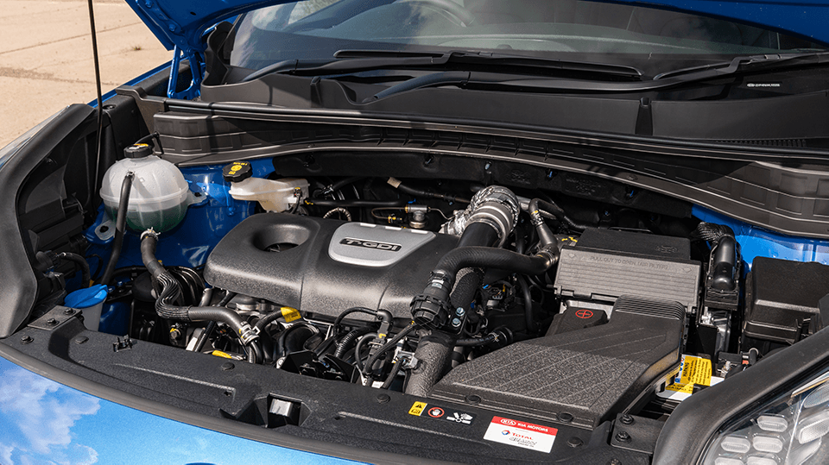
Encapsulation
Object Oriented Programming
All these methods and attributes are encapsulated within the car engine.
This means that the internal workings of the engine are hidden from the outside world.
Note: With encapsulation, the internal state of an object is hidden from the outside world, and interactions with the object are performed only through well-defined methods.

Slide 30

Encapsulation - Real Life Example
Object Oriented Programming
The car owner possesses the key to the car that grants them full access, allowing them to start the engine, unlock the doors, and access other features.
Now, let's say someone else, like a neighbor or a friend, sees the car parked and wants to use it.
However, since they don't have the key, they are unable to access the car or drive it.
The car's lock and key system restricts access to only the owner.
Note: Encapsulation provides a level of access control, ensuring that only authorized users can interact with the class members.

Slide 31
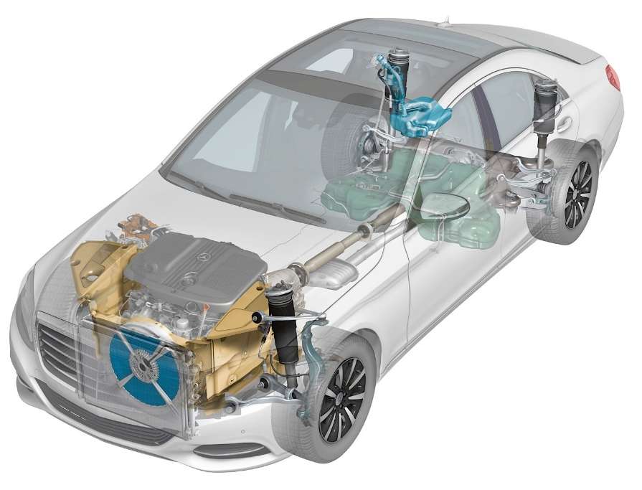

Abstraction vs. Encapsulation
Object Oriented Programming
Encapsulation
Abstraction
Note: Abstraction says what details to be made visible where as Encapsulation provides the level of access right to that visible details.

Slide 32


Inheritance
Object Oriented Programming
Inheritance is a process in which one object gets the capability to acquire all the properties and behaviours of its parent object automatically.
As a result, there is no need to rewrite the code again and again. This ‘Code reusability’ feature avoids code redundancy.
The class from which properties are inherited is called a base class and the class that inherits the properties is called a derived class.
The derived class uses the parent properties and also has its own properties.
Dad, I’m a derived class
It’s Inheritance
Son, I’m a Base class

Slide 33

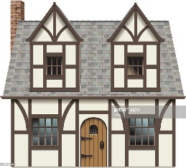




Inheritance
Object Oriented Programming
Note:
Granddad owns a house
Dad inherits the house from grandad and buys a new car
Son inherits the house and car from previous generations and buys a new bike
Gen 1
Grand Dad
Gen 2
House - owns
Gen 3
Inherited from
Dad
House - derives
Car - owns
Inherited from
Son
House - derives
Car - derives
Bike - owns

Slide 34
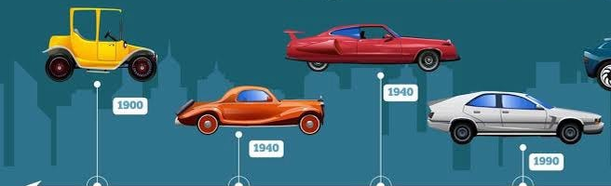
Inheritance – Real Life Example
Object Oriented Programming
Generation 3
Generation 1
Generation 2
Generation 4
Inherited features from Gen 1 + added new features
Inherited features from Gen 1 and 2 + added new features
Inherited features from previous generations + added new features

Slide 35
Types of Inheritance
Object Oriented Programming
There are 5 types of inheritance,
Single level inheritance
Multi-level inheritance
Hierarchical inheritance
Hybrid inheritance
Multiple inheritance

Slide 36
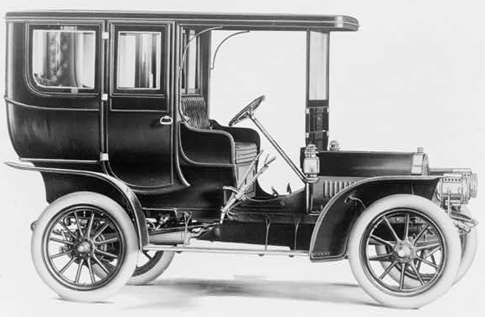
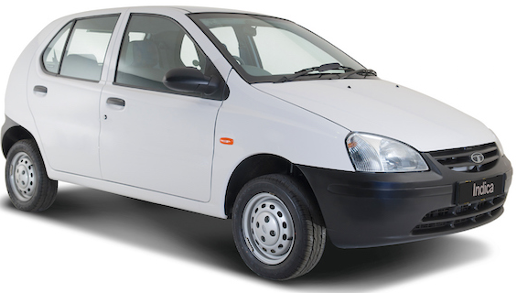
Types of Inheritance
Object Oriented Programming
Single Level Inheritance
In Single-level inheritance, there is a single base class & a single derived class
i.e. - A base car feature is extended by the Tata brand and some new features are added.
Properties
engine
wheels
windows
fuel tank
Behaviour
start()
accelerate()
brake()
turn()
Car
Properties
diesel engine
wheels
windows
fuel tank
speedometer
navigation system
Behaviour
start()
accelerate()
brake()
turn()
Properties from the base class is reused and new features / properties are added.
Tata

Slide 37

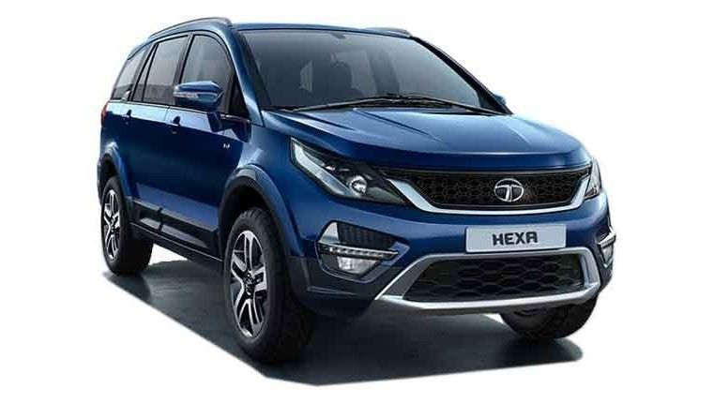
Types of Inheritance
Object Oriented Programming
Multi-Level Inheritance
In Multilevel inheritance, there is more than one single level of derivation.
i.e. - After base features are extended by the Tata brand. Now Tata brand has manufactured its new model with newly added features or advanced features like electric window, and touchscreen controls.
From generalization, getting into more specification.
Properties
engine
wheels
fuel tank
Behaviour
start()
accelerate()
brake()
Car
Properties
speedometer
Behaviour
Tata
Properties
electric windows
touchscreen controls
Behaviour
Tata Hexa

Slide 38
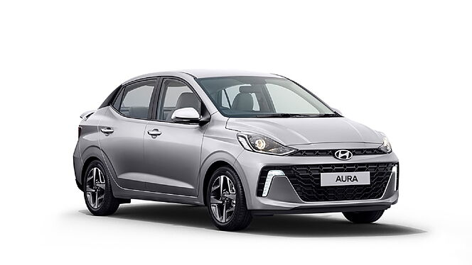
Types of Inheritance
Object Oriented Programming
Hierarchical Inheritance
In this type of inheritance, multiple derived classes would be extended from a base class, it's similar to single-level inheritance but this time along with Tata, Hyundai is also taking part in inheritance.
Properties
engine
wheels
fuel tank
Behaviour
start()
accelerate()
brake()
Car
Properties
speedometer
Behaviour
Properties
electric windows
touchscreen controls
Behaviour
Tata
Hyundai

Slide 39


Types of Inheritance
Object Oriented Programming
Hierarchical Inheritance
Car
Tata Hyundai
Hybrid Inheritance
Single, multilevel, & hierarchical inheritance all together construct hybrid inheritance
Properties
engine
wheels
fuel tank
Behaviour
start()
accelerate()
brake()
Car
Single Inheritance
Car -> Tata
Properties
speedometer
Behaviour
Properties
navigation
Behaviour
Tata
Hyundai
Multi-level Inheritance
Car
|
Tata
|
Tata Hexa
Properties
electric windows
touchscreen
Behaviour
Properties
360-degree camera
Behaviour
Tata Hexa
Hyundai Verna

Slide 40
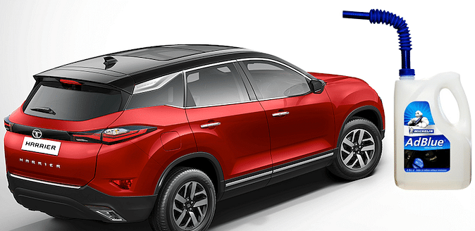

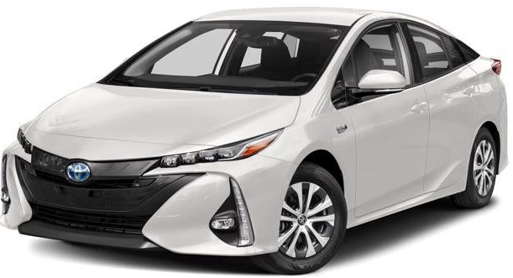
Types of Inheritance
Object Oriented Programming
Multiple Inheritance
Multiple inheritance is where derived class will extend from multiple base classes.
i.e. Tata will use the function of multiple Cars (Gasoline & Electric).
Properties
diesel engine
wheels
fuel tank
speedometer
Behaviour
start()
accelerate()
brake()
Properties
electric motor
wheels
windows
battery pack
Behaviour
start()
accelerate()
brake()
CNG /Gasoline Car
Electric Car
Note: To reduce the complexity and simplify the language, multiple inheritance is not supported in Java language
Properties
hybrid engine
wheels
fuel tank
electric motor
battery pack
Behaviour
start()
accelerate()
brake()
Note: While Java doesn't support multiple inheritance directly, it can be achieved through interface
Hybrid Car

Slide 41



Polymorphism
Object Oriented Programming
Polymorphism is the concept where an object behaves differently in different situations.
More precisely we say it as 'many forms of single entity'.
Speak!!!
Cock a doodle doo…
Meow meow…
Woof woof…

Slide 42







Polymorphism
Object Oriented Programming
Example 1: We turn on the computer by one button at the same time we can turn off the computer by the same button.
Example 2: A person might have a variety of characteristics. He is a man, and he can also be a father, a husband, or an employee. As a result, the same person behaves differently in different situations.

Slide 43

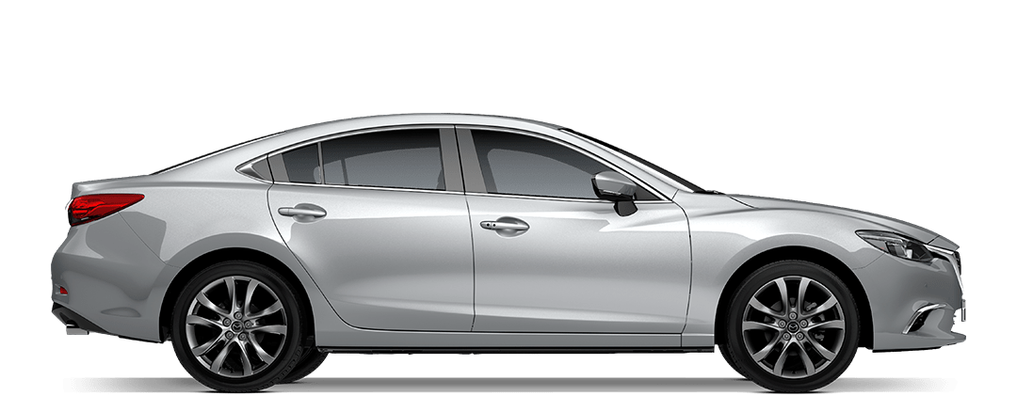

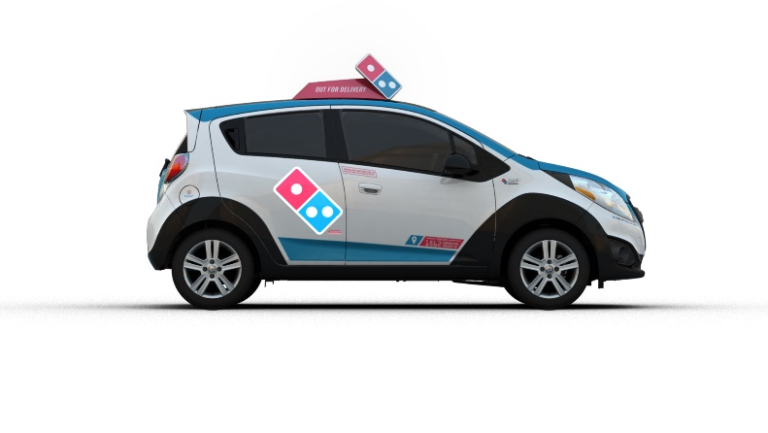

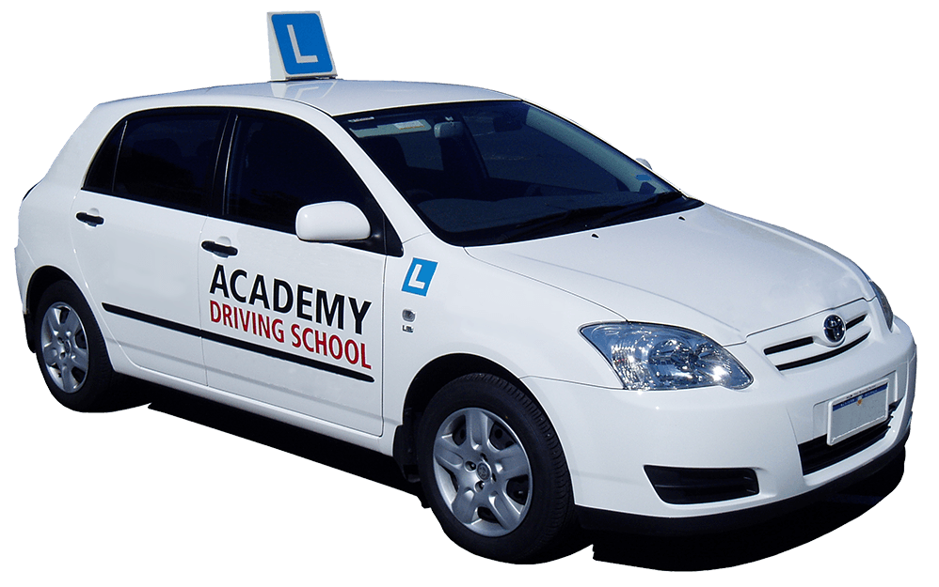

Polymorphism – Real Life Example
Object Oriented Programming
Taxi
Family Car
Car
Delivery Car
Police Car
Race Car
Driving School Car
Note: One car behaves differently in different situations.

Slide 44
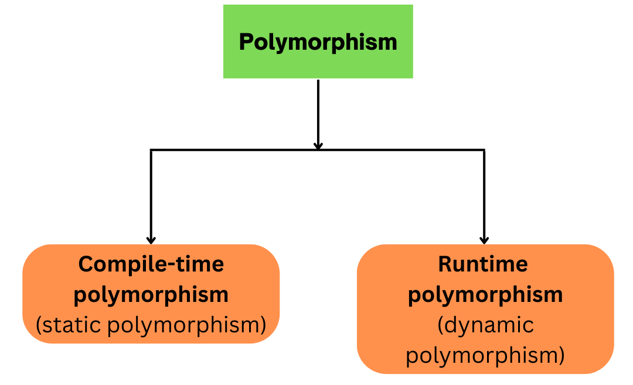
Types of Polymorphism
Object Oriented Programming
Compile-time polymorphism: Decisions about which method to call are made by the compiler. Achieved through method overloading and operator overloading.
Runtime polymorphism: Decisions about which method to call are made at runtime, based on the actual type of the object. Achieved through method overriding.

Slide 45
Types of Polymorphism
Object Oriented Programming
Method Overloading
Method overloading is a feature in programming languages that allows you to define multiple methods/functions in the same class with the same name but with different parameters. This means you can have several methods in a class or module with the same name, but they perform different tasks based on the parameters they receive.
It is one of the ways by which Java achieves Compile Time Polymorphism.

Slide 46
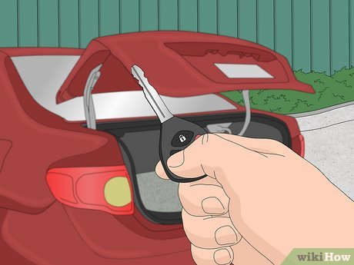
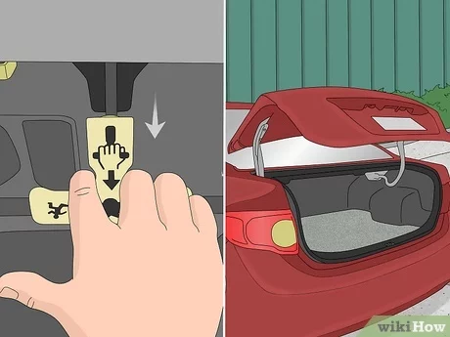
Types of Polymorphism
Object Oriented Programming
Let's say a Car has a trunk i.e. – it is having the functionality of OpenTrunk(). Now the same car has Electronic Trunk Release mode available in the car, so functionality would be the same but with different mode.
The function OpenTrunk() remains the same, but there are two ways to achieve this OpenTruck(key) and OpenTruck(ElectronicTrunkRelease)

Slide 47
Types of Polymorphism
Object Oriented Programming
This type is said to be Static polymorphism or Compile-time polymorphism.
In our example -
Function
OpenTrunk()
OpenTrunk()
Parameter
key
ElectronicTrunkRelease
Note: Same name different signature (parameters) – this is called Method Overloading

Slide 48
Types of Polymorphism
Object Oriented Programming
Method Overriding
Method overriding is a fundamental concept in object-oriented programming (OOP) where a subclass provides a specific implementation of a method that is already defined in its superclass, with the same method signature. This means that a subclass can redefine the behavior of a method inherited from its superclass to suit its own requirements.
It is one of the ways by which Java achieves Run Time Polymorphism.

Slide 49


Types of Polymorphism
Object Oriented Programming
WiperOn() was intended to turn on the wiper automatically when it rains, but suppose Tata had given provision to adjust the wiper manually in case of light rain - Overriding the functionality to turn wiper on manually.

Slide 50
Types of Polymorphism
Object Oriented Programming
This type is called Dynamic polymorphism or Runtime polymorphism.
In our example -
Function
WiperOn()
WiperOn()
Parameter
RainIntensity
RainIntensity
Note: Same name same signature (parameters) – this is called Method Overriding

Slide 51






Association
Object Oriented Programming
Association, aggregation, and composition are concepts related to relationships between classes in object-oriented programming. They are part of the broader concept of "object relationships" in OOP.
Association: This is a more general relationship that indicates how classes are related to each other. It can be a one-to-one, one-to-many, or many-to-many relationship.
For Example: A car has a driver. The relationship between the car and the driver is one of association. The car contains the driver,
but the driver can also exist independently of the car. The driver can drive different cars or engage in other activities besides driving.
There are two types of Association: Aggregation and Composition

Slide 52


Aggregation
Object Oriented Programming
Aggregation: This is a "has-a" relationship, where one class contains another class as a part, but the contained class can exist independently of the container class. It represents a weaker form of ownership. This is also called as weak association.
For Example: A car has wheels. Each wheel is an independent object and can exist separately from the car. If you remove a wheel, it can still be used elsewhere, like in another car or as a spare.

Slide 53


Composition
Object Oriented Programming
Composition: This is also a "has-a" relationship, but with stronger ownership. In composition, the contained class is part of the whole and cannot exist without the container class. This is also referred to as strong association.
For Example: A car has an engine.
The engine is a crucial part of the car; without it, the car cannot function.
The engine is tightly coupled with the car, and if the car is destroyed, the engine is usually unusable in other contexts.

Slide 54
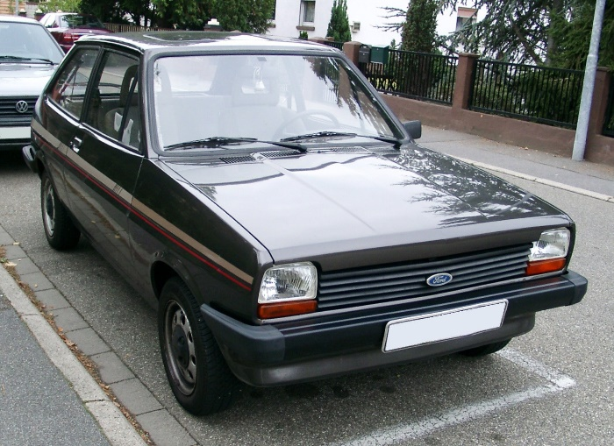

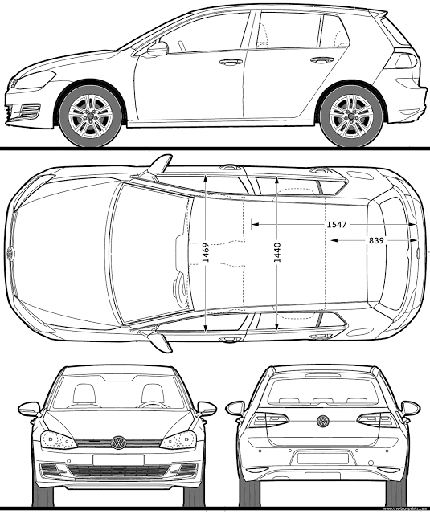
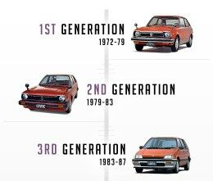

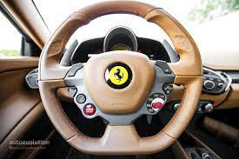

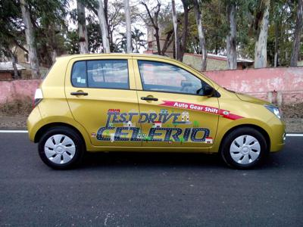

Summary: Car Object
Object Oriented Programming
ENCAPSULATION
CLASS
OBJECT
ABSTRACTION
POLYMORPHISM
INHERITANCE

Slide 55
Procedure Oriented Vs Object Oriented
Object Oriented Programming
POP
The program is divided into functions.
Top-down approach
Every function has different data, so there’s no control over it.
Parts of a program are linked through parameter passing.
Expanding data and function is not easy.
Inheritance is not supported.
OOP
The program is divided into objects.
Bottom-Up approach
Data in each object is controlled on its own.
Object functions are linked through message passing.
Adding new data and functions is easy.
Inheritance is supported in public, private& protected modes.

Slide 56
Procedure Oriented Vs Object Oriented
Object Oriented Programming
POP
No access modifiers supported.
No data hiding. Data is accessible globally.
Overloading is not possible.
No friend function.
No virtual classes or functions.
No code reusability.
Not suitable for solving big problems.
OOP
Access control is done with access modifiers.
Data can be hidden using Encapsulation.
Overloading can be done.
No friend function except C++.
The virtual function appears during inheritance.
The existing code can be reused.
Used for solving big problems.

Slide 57

Quiz
Object Oriented Programming
1) Identify equivalent OOP Principle for the following scenarios.
A person who understands more than two languages yet can converse in any of them depending on the situation.
Answer : Polymorphism

Slide 58
Quiz
Object Oriented Programming
2) Identify equivalent OOP Principle for the following scenarios.
A scientific calculator is a more advanced version of a regular calculator.
Answer : Inheritance

Slide 59
Quiz
Object Oriented Programming
3) Identify equivalent OOP Principle for the following scenarios.
When you go to the bank and tell the banker(Object) to make a deposit(Method) of X dollars into your account(object), the banker will ask for your account number as well as the amount of cash you want to deposit. After a few moments, the banker informs you. Hey, your deposit was completed successfully, and your receipt is attached.
Answer : Abstraction

Slide 60

Quiz
Object Oriented Programming
4) How many objects can you identify in the below picture?
a) 16
b) 2
c) 4
d) 8
Answer : a) 16

Slide 61
Quiz
Object Oriented Programming
5) Is ‘Sound’ an object?
a) Yes
b) No
Answer : a) Yes

Slide 62
Quiz
Object Oriented Programming
6) Class is a collection of object
a) True
b) False
Answer : b) False

Slide 63
Quiz
Object Oriented Programming
7) Which of the following statement is correct?
a) Class is an instance of object.
b) Object is an instance of a class.
c) Class is an instance of data type.
d) Object is an instance of data type.
Answer : b) Object is an instance of a class.

Slide 64
Quiz
Object Oriented Programming
8) Which of the following concepts means wrapping up of data and functions together?
a) Abstraction
b) Encapsulation
c) Inheritance
d) Polymorphism
Answer : b) Encapsulation

Slide 65

Proper Preparation Prevents Poor Performance
- Charlie Batch

